Slide 1

L1 (CHAPTER 2) Data Representation Exercises
Acknowledgement: some slides taken from Yifeng Zhu’s courseware

Slide 2
Decimal, Binary and Hex
Review
Decimal | Binary | Hex
0 | 0000 | 0x0
1 | 0001 | 0x1
2 | 0010 | 0x2
3 | 0011 | 0x3
4 | 0100 | 0x4
5 | 0101 | 0x5
6 | 0110 | 0x6
7 | 0111 | 0x7
8 | 1000 | 0x8
9 | 1001 | 0x9
10 | 1010 | 0xA
11 | 1011 | 0xB
12 | 1100 | 0xC
13 | 1101 | 0xD
14 | 1110 | 0xE
15 | 1111 | 0xF
Prefix 0x denotes hex

Slide 3
Question: Number Conversion
Q: Convert 0x3A56E2F8 into binary
Q: Convert binary number 111010 into hex

Slide 4
Answer: Number Conversion
Q: Convert 0x3A56E2F8 into binary
A: 0011 1010 0101 0110 1110 0010 1111 1000 (simple table lookup for each hex symbol)
Q: Convert binary number 111010 into hex
A: 0x3A (group 111010 into two parts 0011 1010, followed by table lookup)

Slide 5
Adding two integers
Review
-9
+
6
9
flip
+1
-9
1 | 0 | 1 | 1 | 1
0 | 0 | 1 | 1 | 0
01001
10110
10111
23
6
Two’s Complement
Hardware Adder
29
flip
+1
3
1 | 1 | 1 | 0 | 1
00010
00011
Two’s Complement Counterpart
-3
Same bit patterns, different interpretation.
Unsigned addition: 23+6=29
Signed addition: -9+6=-3
This example shows that the hardware adder for adding unsigned numbers, also works correctly for adding signed numbers.
Notes:
{{Pause=1}} We will use a very simple example to show that, the hardware adder for adding unsigned numbers, also works correctly for adding signed numbers. {{Pause=0.5}}
Suppose we are adding negative nine and six. {{Pause=0.5}} These two signed numbers are represented in two’s complement in computers. {{Pause=0.5}}
Specifically, we can obtain the two’s complement representation of negative nine by flipping all bits and adding one. {{Pause=0.5}} The two’s complement of a positive number is itself. {{Pause=0.5}}
Let’s see what will happen if the hardware treats these two inputs as unsigned numbers. If these binary bits represent unsigned numbers, they are 23 and 6, respectively. Therefore, the hardware adds 23 and 6, and produces 29, in decimal, {{Pause=0.3}} or one, one, one, zero, one, in binary. {{Pause=0.5}}
If the output represents a signed integer in two’s complement, it actually represents negative 3. This can be proved by inverting all the bits and adding one. The result, negative three, is exactly the sum of the original signed inputs. {{Pause=0.5}}
This example shows that, without any modification, the hardware adder designed for adding unsigned numbers, works correctly for adding signed numbers.

Slide 6
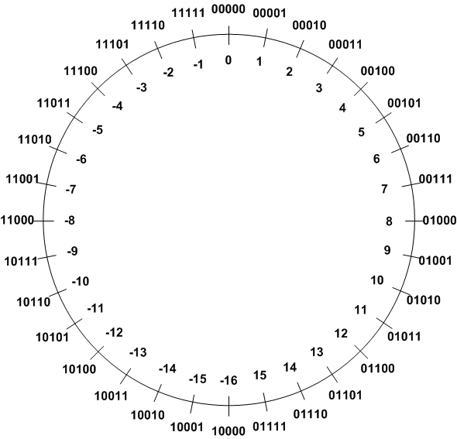

Signed Integers Method 3: Two’s Complement
Review
Two’s Complement ($\overline{α}$):
$$α+\overline{α}=2^{n}$$
TC of a number can be obtained by its bitwise NOT plus one.
Example 1: TC(3)
 | Binary | Decimal
Original number | 00011 | 3
Step 1: Invert every bit | 11100
Step 2: Add 1 | + 00001
Two’s complement | 11101 | -3

Slide 7

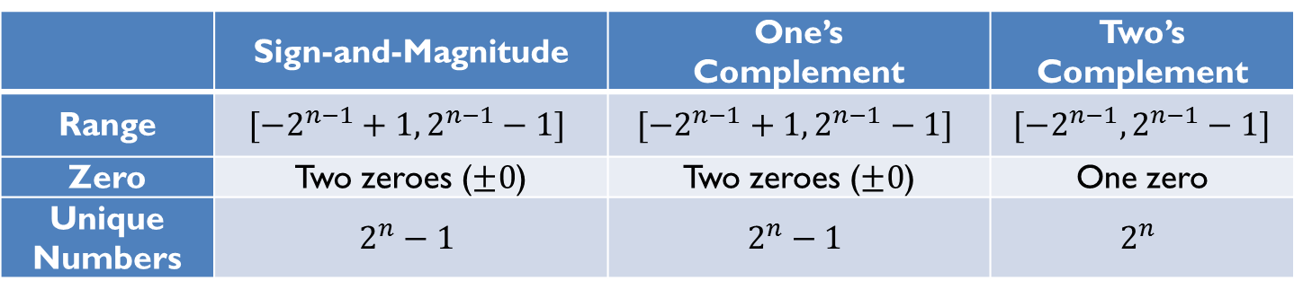
Signed Integer Representation Overview
Review
Three ways to represent signed binary integers:
Signed magnitude
$value={(−1)}^{sign}×Magnitude$
One’s complement ($\tilde{α}$)
$α+\tilde{α}=2^{n}−1$
Two’s complement ($\overline{α}$)
$α+\overline{α}=2^{n}$
 | Sign-and-Magnitude | One’s Complement | Two’s Complement
Range | $$[−2^{n−1}+1, 2^{n−1}−1]$$ | $$[−2^{n−1}+1, 2^{n−1}−1]$$ | $$[−2^{n−1}, 2^{n−1}−1]$$
Zero | Two zeroes ($±0$) | Two zeroes ($±0$) | One zero
Unique Numbers | $$2^{n}−1$$ | $$2^{n}−1$$ | $$2^{n}$$

Slide 8
Question: 2’s Complement
For each of the following binary numbers, give the corresponding binary number of the negative of its value, for 2’s-complement system
(a) x=01010101
(b) x=10101010
(c) x=10000000

Slide 9
Answer: 2’s Complement
For each of the following binary numbers x, give the corresponding binary number of –x in 2’s-complement representation?
(a) x=01010101
-x = 10101011
(b) x=10101010
-x = 01010110
(c) x=10000000
-x=10000000

Slide 10
Question: Number Conversion
Q: What is the decimal value of binary number x=10100111 as either unsigned int, or signed int in 2’s complement representation?
What about x=11100001?
What about x=10000000?

Slide 11
Answer: Number Conversion
Q: What is the decimal value of binary number x=10100111 as either unsigned int, or signed int in 2’s complement representation?
A: if unsigned int, then x=2^7+2^5+2^2+2^1+2^0=167
If signed int, then it is a negative number, since leftmost sign bit is 1. First convert it into its positive counterpart of bitwise NOT plus one to get 01011001, which is equal to decimal 2^6+2^4+2^3+2^0=89. Hence x=-89
Similarly, for x=11100001, first convert it into its positive counterpart of bitwise NOT plus one to get 00011111, which is equal to decimal 31. Hence x=-31
Similarly, for x=10000000, first convert it into its positive counterpart of bitwise NOT plus one to get 10000000, which is equal to decimal 2^7. Hence x=-2^7=-128

Slide 12
Question: Number Conversion
Q: Which number is larger: 1001 or 0011 in binary?
Q: Which number is larger: 0xFFFFFFFF or 0x00000001 in hex?

Slide 13
Answer: Number Conversion
Q: Which number is larger: 1001 or 0011 in binary?
A: depends on the number system.
If unsigned int, then 1001 is 9, and 0011 is 3 in decimal, and 9 > 3
If signed int, then 1001 is -7 (negative of 0111), and 0011 is 3 in decimal, and -3 < 3
Q: Which number is larger: 0xFFFFFFFF or 0x00000001 in hex?
Q: depends on the number system.
If unsigned int, then 0xFFFFFFFF is 2^32-1, and 0x00000001 is 1 in decimal, and 2^32-1 > 1
If signed int, then 0xFFFFFFFF is -1 (negative of 0x00000001), and 0x00000001 is 1 in decimal, and -1 < 1
Notes:
If they represent signed integers, the latter is greater
(-1 < 1).
If they represent unsigned integers, the former is greater
(2³²-1 > 1).

Slide 14
Question: Number Range
Which range of decimals can be expressed with a 6-bit number (assuming Two’s complement representation)?
Answer | Range
A | -32 … 32
B | -64 … 63
C | -31 … 32
D | -16 … 15
E | -32 … 31

Slide 15
Answer: Number Range
Which range of decimals can be expressed with a 6-bit number (assuming Two’s complement representation)?
Answer | Range
A | -32 … 32
B | -64 … 63
C | -31 … 32
D | -16 … 15
E | -32 … 31
$$\left[−2^{n−1}, 2^{n−1}−1\right]=\left[−2^{5}, 2^{5}−1\right]=[−32,31]$$

Slide 16
Question: Number Range
Which range of decimals can be expressed with a 6-bit unsigned integer?
Answer | Range
A | -32 … 32
B | -64 … 63
C | -31 … 32
D | -16 … 15
E | -32 … 31

Slide 17
Answer: Number Range
Which range of decimals can be expressed with a 6-bit unsigned integer?
Answer | Range
A | -32 … 32
B | -64 … 63
C | -31 … 32
D | -16 … 15
E | 0 … 63
$$\left[0, 2^{n}−1\right]=\left[0, 2^{6}−1\right]=[0,63]$$

Slide 18
Question: Integer arithmetic
Q: What is the result of 1001 + 0011?

Slide 19
Answer: Integer arithmetic
Q: What is the result of 1001 + 0011?
A: 1001 + 0011 = 1100
Value of 1100 depends on the number system.
If unsigned int, then 1100 is 12, which is equal to 9 (1001) + 3 (0011)
If signed int, then 1100 is -4 (negative of 0100), which is equal to -7 (1001) + 3 (0011) in decimal

Slide 20
Summary of Carry and Overflow Flags
Review
Bit | Name | Meaning after add or sub
N | negative | result is negative
Z | zero | result is zero
V | overflow | signed overflow
C | carry | unsigned overflow
Carry flag C = 1 upon an unsigned addition if the answer is wrong (true result > 2^{n}-1)
Carry flag C = 0 (Borrow flag = 1) upon an unsigned subtraction if the answer is wrong (true result < 0)
Overflow flag V =1 upon a signed addition if the answer is wrong (true result > 2^{n-1}-1 or true result < -2^{n-1})
31
0
N
Z
C
V
20
CPSR (Current Program Status Register)
Notes:
C is cleared upon an unsigned subtract if the answer is wrong

Slide 21
Signed or unsigned
Review
Whether the carry flag or the overflow flag should be used depends on the programmer’s intention.
uint a;
uint b;
…
c = a + b
…
int a;
int b;
…
c = a + b
…
C Program
C Program
Check the carry flag
for unsigned addition
Check the overflow flag
for signed addition

Slide 22
Question: Addition
Q: Consider a 4-bit system. What is the result of addition 1011+0110, assuming either unsigned integers, or signed integers in 2’s-complement representation？

Slide 23
Answer: Addition
Q: Consider a 4-bit system. What is the result of addition 1011+0110, assuming either unsigned integers, or signed integers in 2’s-complement representation？
A: A 4-bit unsigned int has the range [0,2⁴-1]=[0, 15]; a 4-bit signed int has the range [-2³, 2³-1]=[-8, 7]
1011 is 11 in decimal as unsigned int; -5 in decimal as signed int; 0110 is 6 as either unsigned or signed int.
1011+0110 = 10001; the extra leftmost bit is discarded, so the result is 0001 (1 in decimal) for both cases.
For unsigned addition, true result should be 11+6=17 in decimal. Since 17>15, the result is wrong, and Carry flag is set to 1.
For signed addition, true result should be -5+6=1 in decimal. So the result is correct.

Slide 24
Question: Subtraction
Q: Q: Consider a 4-bit system. What is the result of subtraction 1011-0110, assuming either unsigned integers, or signed integers in 2’s-complement representation？

Slide 25
Answer: Subtraction
Q: Consider a 4-bit system. What is the result of subtraction 1011-0110, assuming either unsigned integers, or signed integers in 2’s-complement representation？
A: 1011-0110 = 0101, so the computed result is 0101 (5 in decimal) for both cases.
For unsigned subtraction, true result should be 11-6=5 in decimal. So the result is correct
For signed subtraction, true result should be -5-6=-11. Since -11 < -8, the result of 5 is wrong, and Overflow flag is set to 1.

Slide 26
Question: Subtraction
Q: Consider a 4-bit system. What is the result of subtraction 0110-1011, assuming either unsigned integers, or signed integers in 2’s-complement representation？

Slide 27
Answer: Subtraction
Q: Consider a 4-bit system. What is the result of subtraction 0110-1011, assuming either unsigned integers, or signed integers in 2’s-complement representation？
A: 0110-1011 = 1011, so the computed result is 11 in decimal for unsigned, or -5 in decimal for signed.
For unsigned subtraction, true result should be 6-11=-5 in decimal. Since -5 < 0, the result is wrong, and Carry flag is 0 (Borrow flag is 1).
For signed subtraction, true result should be 6-(-5) =11. Since 11 > 7, the result is wrong, and Overflow flag is set to 1.

Slide 28
Question: True or False
1. Overflow is impossible when subtracting one unsigned number from another.
2. Overflow is impossible when subtracting two signed operands of the same sign.
3. There are two representations of zero in 2’s complement representation.
4. In 2’s complement, the absolute values of full-scale negative and full-scale positive are identical

Slide 29
Answer: True or False
1. Overflow is impossible when subtracting one unsigned number from another. False
2. Overflow is impossible when subtracting two signed operands of the same sign. True
3. There are two representations of zero in 2’s complement representation. False
4. In 2’s complement, the absolute values of smallest negative and largest positive numbers are identical. False

